Slide 1

PARKE ALEXANDER SHEKHAR (M00832048) VISHEK RAMGOLAM(M00851334) CST 1500 COMPUTER SYSTEMS ARCHITECTURE AND OPERATING SYSTEMS 22 MARCH 2022
CALCULATOR (PYTHON COURSEWORK 3)

Slide 2
TABLE OF CONTENT
INTRODUCTION
TOOLS
PROJECT

Slide 3

INTRODUCTION

Slide 4
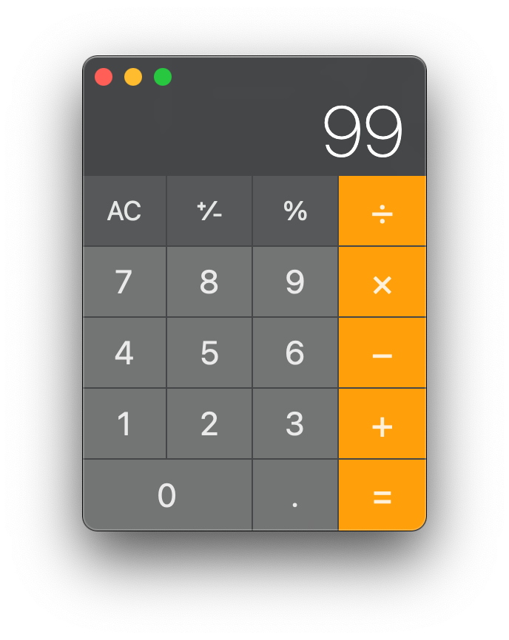
TASK
Design a basic calculator, with a fully functional GUI

Slide 5
WHAT WAS DONE?
Discuss the mathematical functions to be added
Design the layout of the calculator
Where will the buttons be placed?
e.g. Number pad is placed to the right
Discuss the appearance of the calculator
Size of calculator GUI frame
Size of buttons
Colours to use

Slide 6
TEAM STRUCTURE
Creating the class and buttons
Creating the math formula functions for trigonometric operations (sin, cos, tan, sinh, cosh, tanh)
Creating the threads

Slide 7
TOOLS

Slide 8
TOOLS USED: LIBRARIES
tkinter
Library that allows us to create a GUI
Pillow
Library pillow has been used to insert an image in the GUI
Tkmacosx
This library allows for the change in background colour of a button in mac os

Slide 9
TOOLS USED: LIBRARIES
threading
Library that allows creation of threads that permits simultaneous output of multiple lines of code
math
Library that makes more mathematical functions available for use

Slide 10
TOOLS USED: METHODS
Class
An object constructor or a “blueprint” used to create objects
Instance
An object or an occurrence of a class

Slide 11
TOOLS USED: TUTORIAL & RESEARCH
https://www.geeksforgeeks.org/
https://stackoverflow.com/

Slide 12
PROJECT

Slide 13
WHAT WAS ACHIEVED
The calculator GUI has been designed and runs without issues
All libraries included in the program have been used
A few functionalities other than the mandatory requirements have been added in the program
Mathematical functions have not been limited to basic operations such as addition, subtraction, multiplication, division(A wide range of operations have been added)

Slide 14
PROJECT FEATURES
Translucent background
Colours
(Orange, Gray, Green, Red)
Multithreading
Memory recall(display last results as input and display all results obtained from all operations)
Most features will be shown during the demo

Slide 15
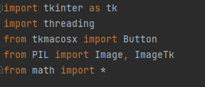
PROJECT FEATURES
Importing libraries

Slide 16

PROJECT FEATURES
Creating function

Slide 17
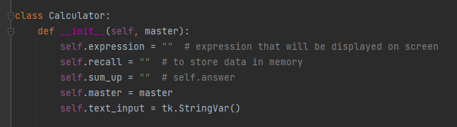
PROJECT FEATURES
Class method creation

Slide 18
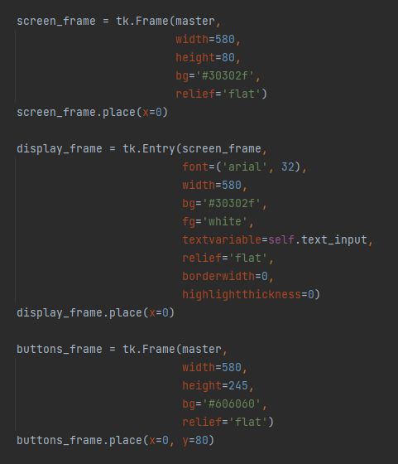
PROJECT FEATURES
Creating the frames of the calculator

Slide 19
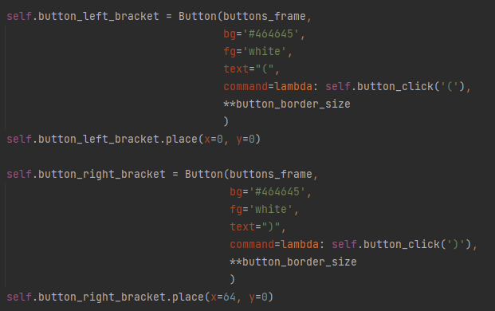
PROJECT FEATURES
Creating GUI buttons

Slide 20
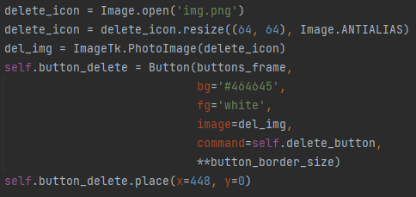
PROJECT FEATURES
Importing an image to use as the delete icon

Slide 21
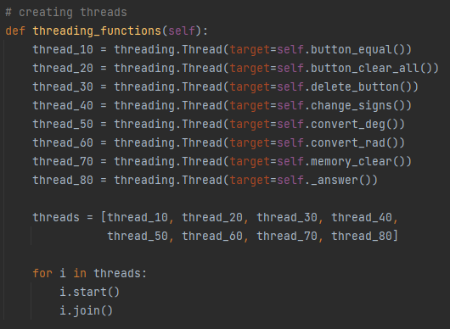
PROJECT FEATURES
Creating and starting threads

Slide 22
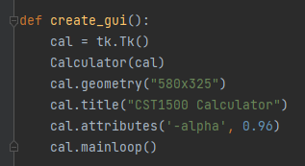
PROJECT FEATURES
Creating instance of class and GUI

Slide 23
ACKNOWLEDGEMENT
We would like to thank Mrinal Sharma for his assistance in helping us develop this program

